Slide 1
MARKETING MEASUREMENT AND RESOURCE ALLOCATION
Dr. Ceren Kolsarici

Slide 2
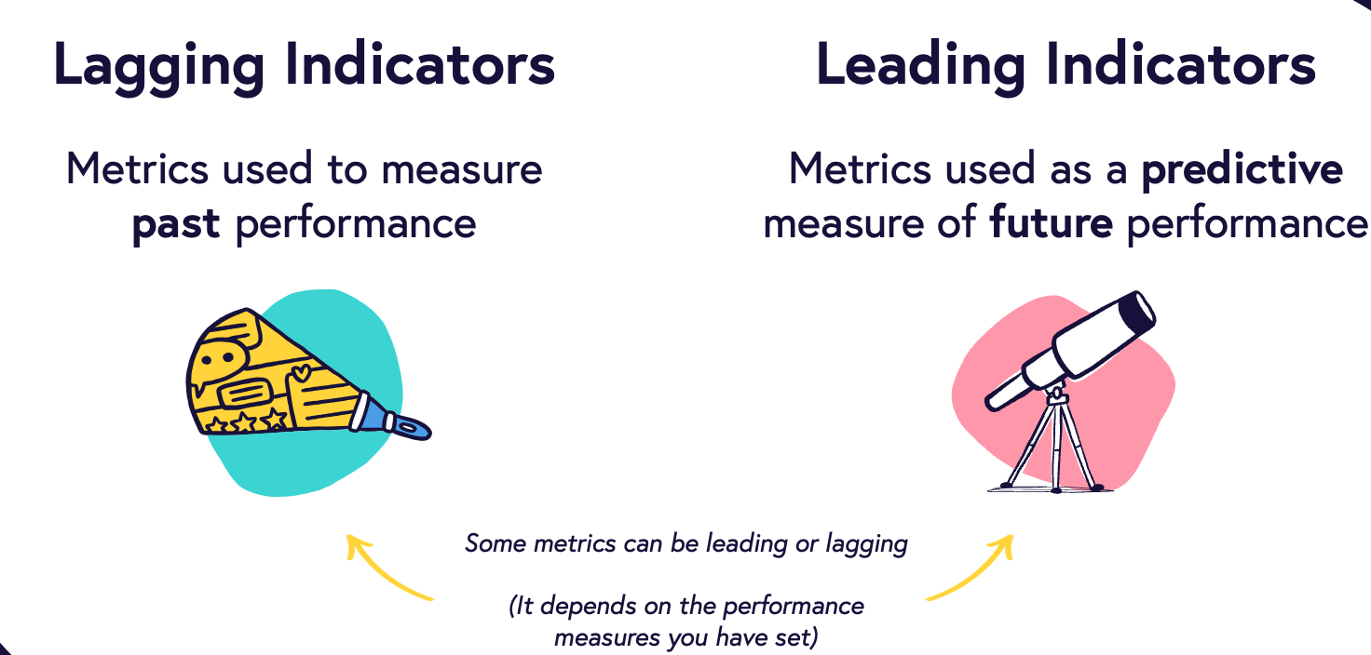
MARKETING METRICS

Slide 3
Performance Measurement Comes First
Marketing, too often, is perceived as a "cost" to the company than an "investment".
Where does marketing belong? P&L vs. Balance Sheet
Marketing budgets are the first in line when it comes to budget cuts and last when it comes to source of long-term growth.
Bizarre? Yes! Who to blame?
Marketers are, and should be, accountable for their decisions.
A & AI are great tools we have measuring marketing performance; justifying and revising strategic and tactical plans.

Slide 4
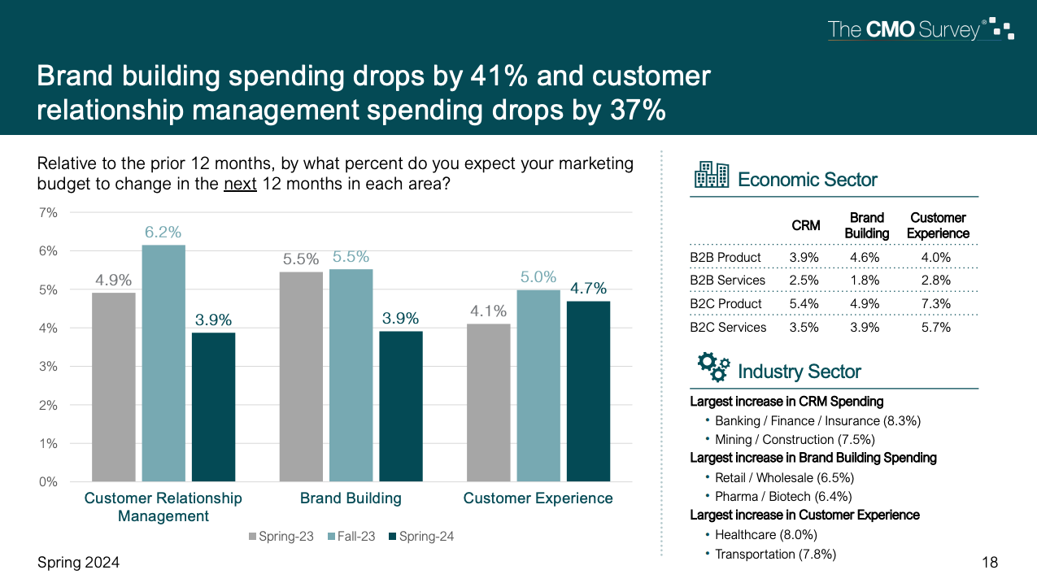

Slide 5
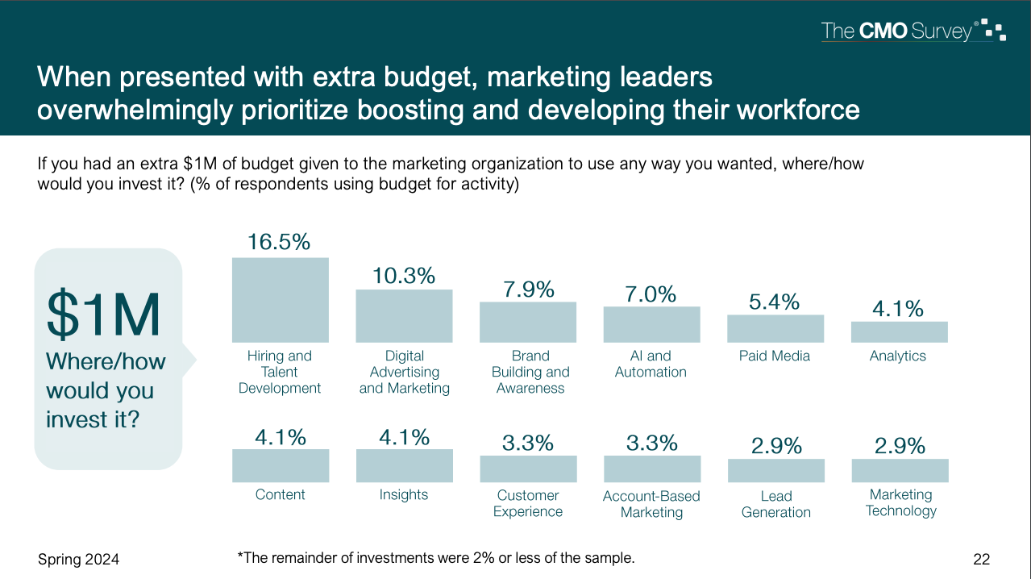

Slide 6
Challenge: Which Metric(s) to Use? When?
Marketing performance measurement is multidimensional. A firm needs at least as many metrics as it has goals.
Soft metrics relate to the non-financial benefits which (might or might not) act as a precursor to revenue. (e.g. engagement, awareness, conversion rate, conversations, mentions)
Soft metrics have become more relevant with the proliferation of new media. Therefore, firms need to use both types of metrics to assess marketing performance.
Hard metrics directly measure the financial impact on the firm's bottom-line or top-line. (e.g. ROI, ROMI, elasticity, customer equity, net present value)
Hard metrics are relatively harder to calculate and soft metrics are more challenging to interpret (i.e. moving beyond the "so what?")

Slide 7
Not All Metrics Are Created Equal
Two types:
Lagging Indicators: Measure past results or end results of previous marketing activities
Leading Indicators: Marketing input that lead the results of the lagging indicators
LEADING INDICATORS
Emails Sent
Daily Active Users
Social Media Posts Shared
Net Promoter Score
Product Adoption
…
LAGGING INDICATORS
Revenue Growth
Customer Acquisition Costs
Churn Rate
Customer Satisfaction
Renewal Rates
…

Slide 8
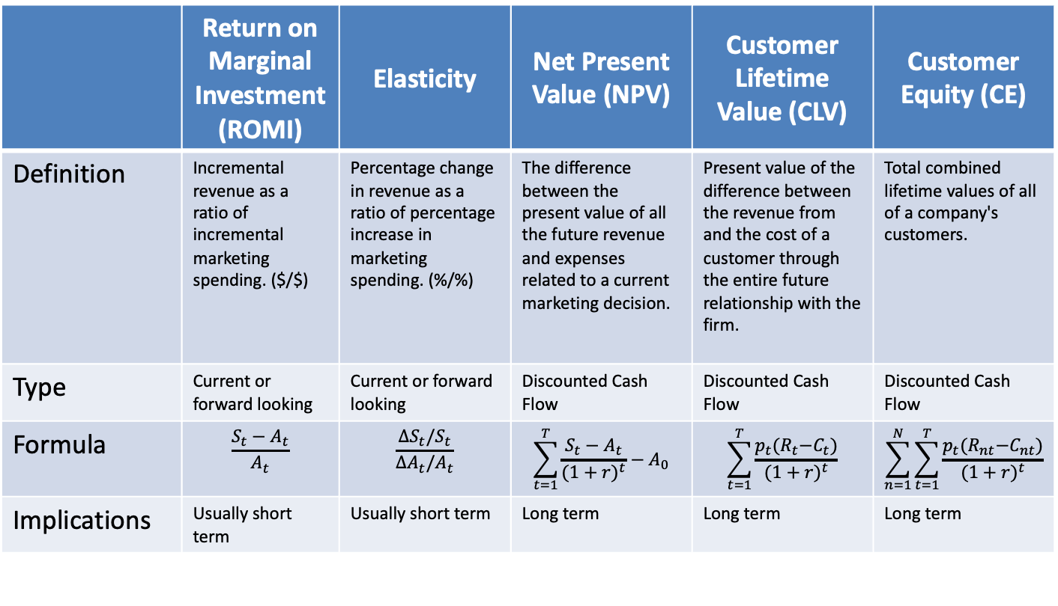
Hard Metrics
There are many, but below are my top five.
 | Return on Marginal Investment (ROMI) | Elasticity | Net Present Value (NPV) | Customer Lifetime Value (CLV) | Customer Equity (CE)
Definition | Incremental revenue as a ratio of incremental marketing spending. ($/$) | Percentage change in revenue as a ratio of percentage increase in marketing spending. (%/%) | The difference between the present value of all the future revenue and expenses related to a current marketing decision. | Present value of the difference between the revenue from and the cost of a customer through the entire future relationship with the firm. | Total combined lifetime values of all of a company's customers.
Type | Current or forward looking | Current or forward looking | Discounted Cash Flow | Discounted Cash Flow | Discounted Cash Flow
Formula | $$\frac{S_{t}−A_{t}}{A_{t}}$$ | $$\frac{ΔS_{t}/S_{t}}{ΔA_{t}/A_{t}}$$ | $$\sum_{t=1}^{T}{\frac{S_{t}−A_{t}}{{(1+r)}^{t}}−A_{0}}$$ | $$\sum_{t=1}^{T}{\frac{p_{t}{(R}_{t}−C_{t})}{{(1+r)}^{t}}}$$ | $$\sum_{n=1}^{N}{\sum_{t=1}^{T}{\frac{p_{t}{(R}_{nt}−C_{nt})}{{(1+r)}^{t}}}}$$
Implications | Usually short term | Usually short term | Long term | Long term | Long term
t: time, S: sales($), A: ad spending ($), r: discount rate,
R: revenue from a customer, C: cost of serving a customer, n: customer, p: retention rate

Slide 9

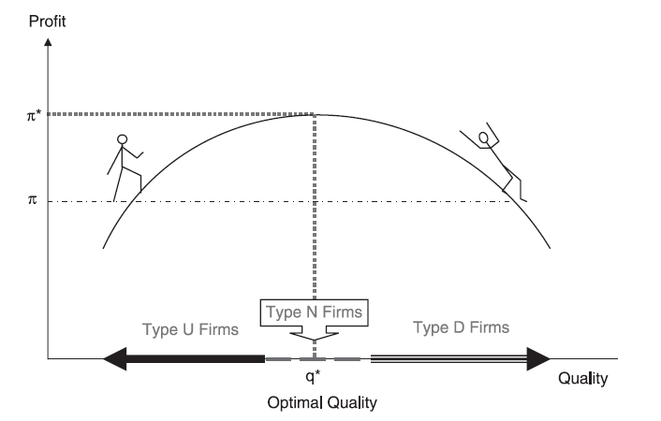
Marginal (ROMI) v. Average (ROI) Returns
ROI is tailored to evaluate one-time capital projects.
Is marketing a one-time capital project?
Maximum ROI is not always maximum profit
Law of diminishing returns
Does the highest ROI correspond to the best spending level?
Should you stop spending when ROI drops even if you’re making bigger profits?
ROMI
The point where you stop depends on the return of the last incremental $ spent, not the overall ROI
Uphill or Downhill? Locating the Firm on a Profit Function, Murali K. Mantrala, Prasad A. Naik, Shrihari Sridhar and Esther Thorson, Journal of Marketing , Vol. 71, No. 2 (Apr., 2007), pp. 26-44

Slide 10
YOU CAN’T IMPROVE WHAT YOU CAN’T MEASURE

Slide 11
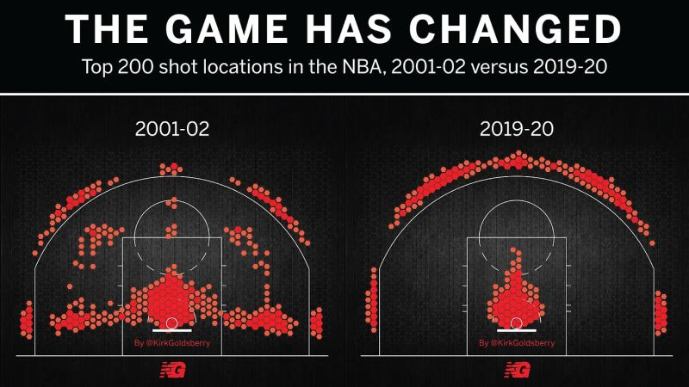
MUSIC, MOVIES, SPORTS, TIKTOK REELS… IT’S ALL THE SAME-BUT-SLIGHTLY-DIFFERENT
Is Data-driven synonymous for boring?
How can we find balance between creativity and science?

Slide 12
Questions A & AI Help You Answer in Marketing
Was your marketing effective? Efficient?
If we get 20% more budget, where should we spend it on?
If we need to cut 20% from our budget, what should go?
How much does our marketing action affect performance, in the short- and long-term?
Which marketing action gives us the highest lift? How does it compare to industry benchmarks?
…

Slide 13
Methodological Approaches for Measurement
Intuition: Own experience, heuristics or benchmarks
Happens in the absence of good data
Ask salesforce (i.e. be careful about biases)
Works well for the direction to the change in budget size (e.g. A/S, SOV/SOM, media consumption ~ media budget)
Experiments (primary data)
Controlled setting
Causality is measured
Mostly suitable for tactical decisions (e.g. ad content or channel design)
Regression and/or ML based approaches using secondary (observed) data
Goal: To understand how we can use the analytical results in decision making
(i.e. What to do with these results?)

Slide 14
Do you Stop Advertising in a Crisis¹: P&G vs Coca-Cola
Procter & Gamble doubled down on marketing when COVID hit, while Coca-Cola went dark. The former’s revenues surged, the latter’s dwindled.
How does the pattern differ for big brands vs. small brands?
Source: https://www.marketingscience.info/when-brands-stop-advertising/
1 – Just 7% of all brands seized the opportunity to invest more in advertising during COVID-19

Slide 15
Barriers Against Proper Use of A & AI
Intuition works well enough for general direction of the changes/effects.
Unclear benefits of A & AI
Financial and switching costs are high.
→Deal breakers especially if firms fail to ask the right questions and/or generate actionable insights from the results.
Online platforms provide easy access metrics for free (e.g. likes, visits, clicks) and decision makers think they suffice.
→ As how a “like” translates into conversion. Does it?
Little/no trust in the organization that doing the best for the organization will actually get you ahead in your career.
→ Which one is better: Top down or bottom up?

Slide 16
WHAT IS “GOOD” CAMPAIGN MEASUREMENT?
Why Methodology Matters

Slide 17
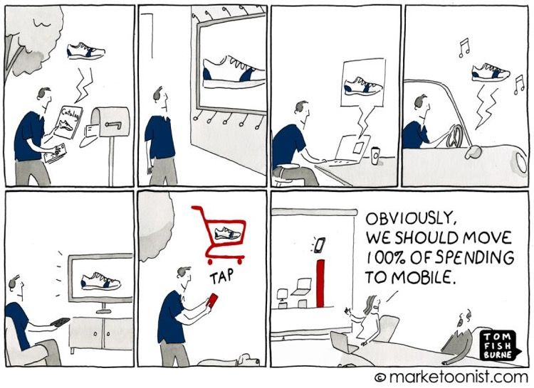
True Attribution Need Both Brand Tracking and MTA
See the broader purchase path beyond what attribution alone can show you to fully understand how to best allocate your budget and optimize your marketing strategy.

Slide 18
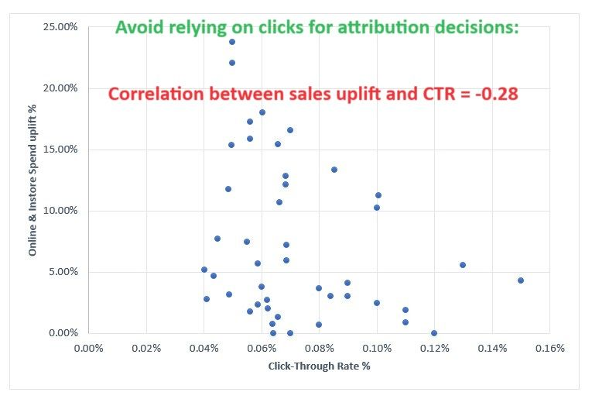
CTR: Among the Most Misleading Metrics for Digital Budget Allocation
Correlation CTR and ROI: -0.07 (Nielsen study 2009)
Correlation clicks and conversions: 0.01 (ComScore study 2012)
Correlation CTR and purchase intent: <0.01 (Nielsen study 2014-2015)
Correlation CTR and incremental sales: -0.28 (Dunnhumby study 2019)
Correlation CTR and conversion rate: -0.01/-0.02 (Quantcast study 2021)
Digital ads, even within platforms, should be assessed using AB tests (RCT) for budgeting decisions. Highly granular media/ marketing mix models (MMM) should be used as a complement.
Should CTR be ignored entirely?
https://www.nielsen.com/insights/2009/is-the-ad-biz-through-with-click-through/ https://www.comscore.com/Insights/Press-Releases/2012/4/For-Display-Ads-Being-Seen-Matters-More-than-Being-Clicked https://www.ianbarnard.ca/post/the-worst-social-media-metric-according-to-facebook https://www.warc.com/newsandopinion/opinion/click-through-rate-is-well-past-its-sell-by-date/2993 https://www.quantcast.com/wp-content/uploads/2021/09/lead-generation-driving-customer-conversions-not-clicks.pdf

Slide 19



The Goal of Campaign Measurement
Calculate the incremental impact of marketing action
The lift, above and beyond a defined baseline, that is specifically attributable to a focal marketing effort
Scenario A: Exposure
Liberty Hotels Lykia
Liberty Hotels Lykia
Conversions

Slide 20

The Goal of Campaign Measurement
Calculate the incremental impact of marketing action
The lift, above and beyond a defined baseline, that is specifically attributable to a focal marketing effort
Scenario B: No Exposure
Conversions

Slide 21
Randomized Controlled Trials (RCTs)
RCTs are the “gold standard” in ad measurement as they allow for the measurement of causal impact of ad exposure
Source: Gordon et al. (2016), A Comparison of Approaches to Advertising Measurement: Evidence from Big Field Experiments at Facebook

Slide 22
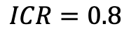
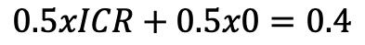
Conversion Lift Calculation
Lift = 0.4 % points ~ 50%
$$0.5xICR+0.5x0=0.4$$
$$ICR=0.8$$
?
Source: Gordon et al. (2016), A Comparison of Approaches to Advertising Measurement: Evidence from Big Field Experiments at Facebook

Slide 23
Conversion Lift Calculation
Counterfactual
1.0%
The power of the RCT is that it gives us a way to measure what we can't observe, namely, what would have happened in the alternative world in which people who actually saw the ad didn't see the ad.
=0.8
Source: Gordon et al. (2016), A Comparison of Approaches to Advertising Measurement: Evidence from Big Field Experiments at Facebook

Slide 24
Observational Methods to Improve Measurement
Comparing the exposed and unexposed groups is inappropriate because they contain different compositions of consumers. But if we can observe how the groups differ based on characteristics observed in the data, can we take them into account in some way that improves our estimates of advertising effectiveness?
Regression adjustment employs flexible regression methods to control for differences in exposed and unexposed groups to isolate the effect of ads
Propensity score matching matches exposed and unexposed users with similar likelihoods of exposure based on a variety of attributes (age, gender, zip code, behavior)
Exact matching constructs equivalent comparison groups by matching one exposed user to one unexposed user

Slide 25
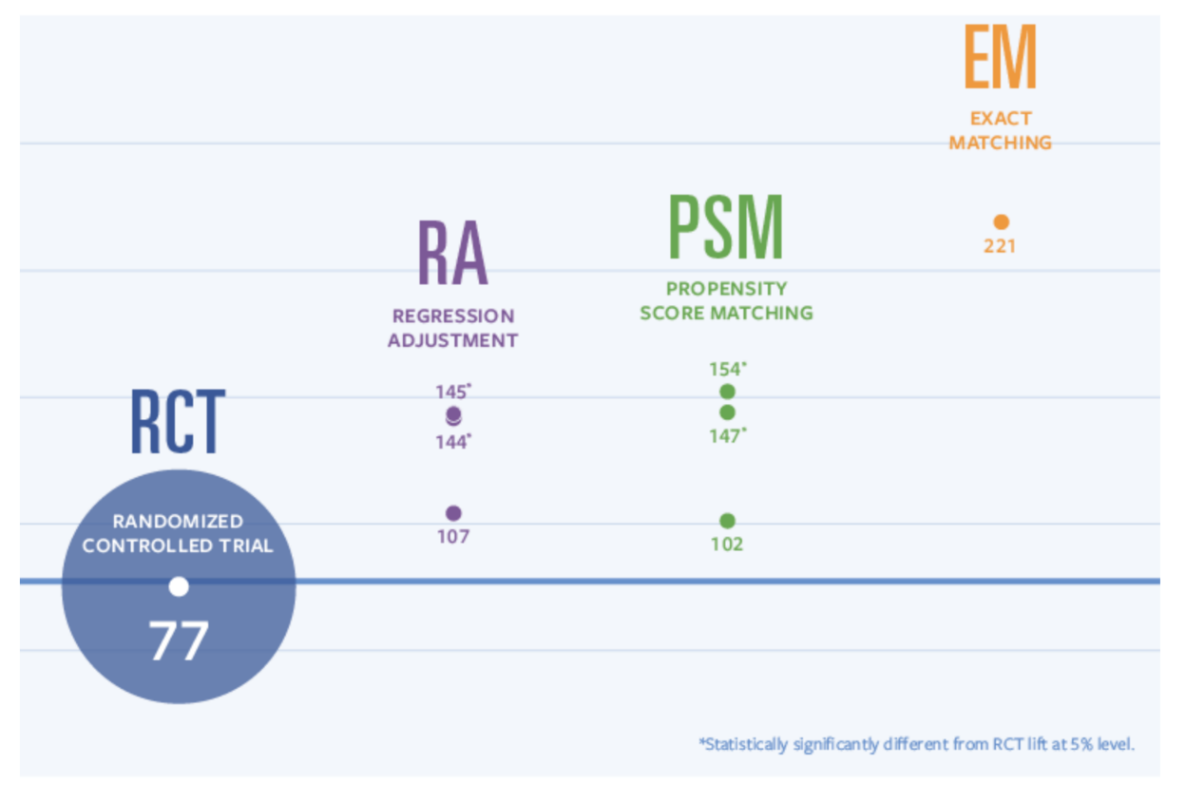
Conversion Lift: RCTs vs Observational Methods
The results of 12 Us-based Facebook ad campaigns totaling over 1.4 billion impressions across industries and marketing objectives.
METHODOLOGY MATTERS

Slide 26
BUDGETING DECISIONS
ACTIONS BASED ON MEASUREMENT

Slide 27
Justify Your Marketing Budget
Focus on alignment with business strategies and priorities
Build a business partnership with the CFO
Explain hypothesis (Consumer behavior process)
Measure impact on brand and consumer metrics
Create a full funnel view
Build a collaborative relationship with C-suite peers
Run RCTs
Don’t ignore impact on marketing costs
Appreciate metrics to budget connection (i.e. ROI)
Move to an investment mentality (ad carryover, brand goodwill/stock)
Source: Moorman and Veenstra, Making a Business Case for Your Marketing Budget, Harvard business Review, November 12, 2021
Notes:
https://hbr.org/2021/11/making-the-business-case-for-your-marketing-budget?ab=hero-subleft-2

Slide 28
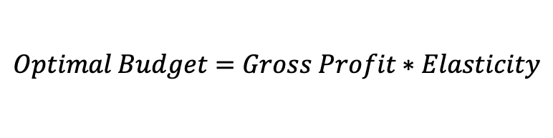
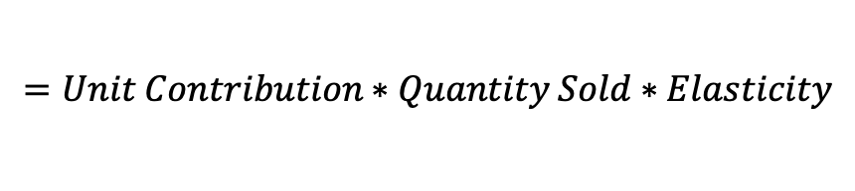
Optimization of the Marketing Budget
Profit is maximized when ad budget equals gross profit times the advertising elasticity
(Dorfman-Steiner Theorem 1954)
$$Optimal Budget=Gross Profit∗Elasticity$$
$$=Unit Contribution∗Quantity Sold∗Elasticity$$
If your advertising becomes 3x effective, should you spend more or less on marketing?
Spend more on activities with higher elasticity
Spend more when higher unit contribution margin
Spend less when lower expected sales (unless you can obtain higher marketing elasticity)
Source: Wright (2009), A New Theorem of Optimizing Marketing Budget, Journal of Advertising Research, DOI: 10.2501/S0021849909090229
Notes:
A Neoclassical Economics Theorem

Slide 29
How to Allocate the Budget: Ratio of Elasticities
You know that doubling your spending on paid-search lift conversion rate by 15% and doubling spending on display advertising only leads to a 10% increase. How should you divide your total budget of $1M between these two channels?
Approach:
Sum up elasticities: .15+.10=.25
Calculate the contribution of each channel to the aggregate elasticity: .15/.25=60% → Paid Search, .10/.25=40% → Display
Allocate proportional to the ratio of contributions:
$600K → Paid Search
$400K → Display

Slide 30
Refresher: Elasticity versus ROMI
Elasticity
ROMI
Measures % change in demand as a result of % change in marketing efforts
Measures unit change in demand as a result of unit change in marketing efforts
Both provide insights about how responsive the market is to the firm's actions, albeit, through different metrics.
Notes:
So let’s juxtapose elasticity vs. ROI.

Slide 31
Marketing roi & Elasticity
DID THE RESOURCE ALLOCATION WORK?

Slide 32
Does Marketing-Mix Pay Off?
The goal of marketing analytics is to determine the effectiveness of a company's various marketing strategies. For each strategy, the company is looking to assess its ROI.
Financial ROI is equal to profit over investment value. Marketing ROI, on the other hand, is equal to profits related to marketing measures divided by value of the marketing investment (i.e. money risked, as opposed to, money invested).

Slide 33
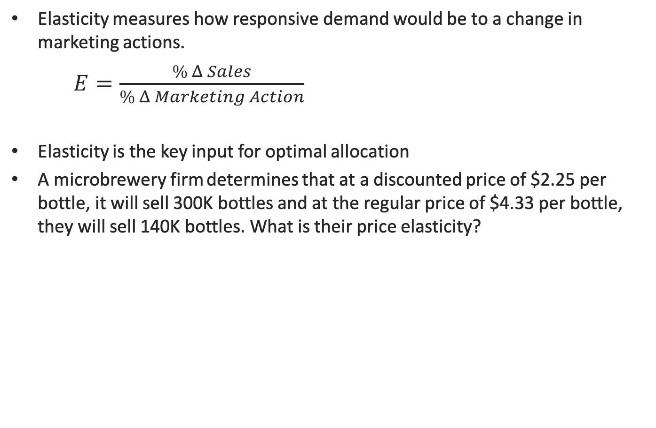
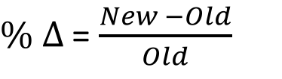
Refresher: Marketing Mix Elasticity
Elasticity measures how responsive demand would be to a change in marketing actions.
$E=\frac{\% Δ Sales}{\% Δ Marketing Action}$
Elasticity is the key input for optimal allocation
A microbrewery firm determines that at a discounted price of $2.25 per bottle, it will sell 300K bottles and at the regular price of $4.33 per bottle, they will sell 140K bottles. What is their price elasticity?
where
$\% Δ$ = $\frac{New −Old}{Old}$

Slide 34
Refresher: Marketing Mix Elasticity
Elasticity measures how responsive demand would be to a change in marketing actions.
$E=\frac{\% Δ Sales}{\% Δ Marketing Action}$
Elasticity is the key input for optimal allocation
A microbrewery firm determines that at a discounted price of $2.25 per bottle, it will sell 300K bottles and at the regular price of $4.33 per bottle, they will sell 140K bottles. What is their price elasticity?
where
$\% Δ$ = $\frac{New −Old}{Old}$
 | Interpreting Elasticity
Sign | + | 0 | -
Magnitude | Abs(E)>1 | Abs(E)=1 | Abs(E)<1

Slide 35
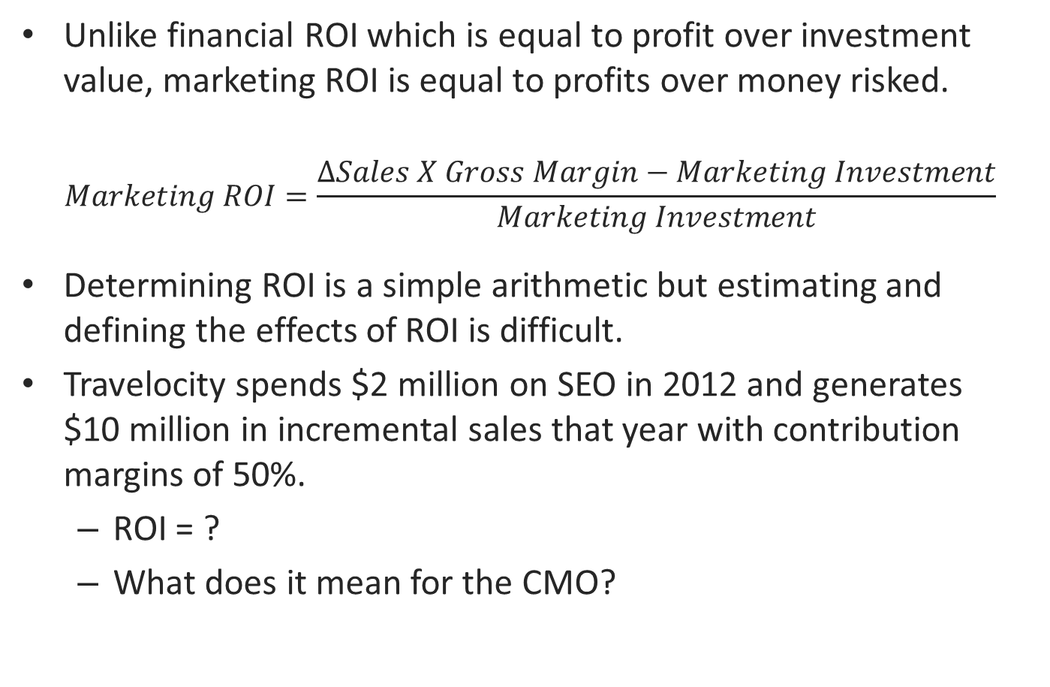
Understanding the Effects of ROI is the Challenge
Unlike financial ROI which is equal to profit over investment value, marketing ROI is equal to profits over money risked.
$$Marketing ROI=\frac{∆Sales X Gross Margin−Marketing Investment}{Marketing Investment}$$
Determining ROI is a simple arithmetic but estimating and defining the effects of ROI is difficult.
Travelocity spends $2 million on SEO in 2012 and generates $10 million in incremental sales that year with contribution margins of 50%.
ROI = ?
What does it mean for the CMO?
Notes:
Will investment in 2012 also pay dividends in 2013? How was incremental gross margin calculated? What is the baseline without SEO? What are the long term effects and what is the CLV of customers acquired by this campaign?
ROI=1.5

Slide 36
The Goal of Analytics is to Guarantee Accuracy of the Incremental Sales Estimation
So many more questions before we can make sense of the ROI figure:
Will investment in 2012 also pay dividends in 2013? (i.e. are there any carryover effects of SEO)
How was incremental gross margin calculated?
What is the baseline without SEO?
Will doubling the investment to $4M double the return to $20 in incremental sales? (i.e. relates back to the importance of identifying the right specification)
What are the long term effects and what is the CLV of customers acquired by this campaign?
The goal of analytics is to accommodate these nuances of marketing influence on sales so that the estimate of incremental sales is an accurate reflection of reality.
Be mindful of the type of ROI you are interested in!

Slide 37
Elasticity versus ROMI
Elasticity
ROMI
Measures % change in demand as a result of % change in marketing efforts
Measures unit change in demand as a result of unit change in marketing efforts
Both provide insights about how responsive the market is to the firm's actions, albeit, through different metrics.

Slide 38
Average versus Marginal ROI (Elasticity)
A Linear response curve
Sales response curve with diminishing returns
Sales
Sales
Investment
Investment
Average metrics assume linear response curves. But in reality, market response is likely non-linear. Therefore, marginal metrics provide more realistic insights.

Slide 39
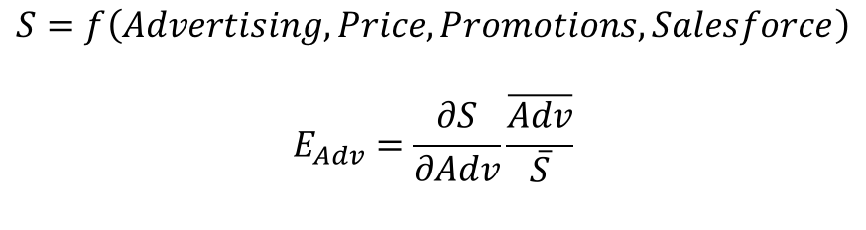
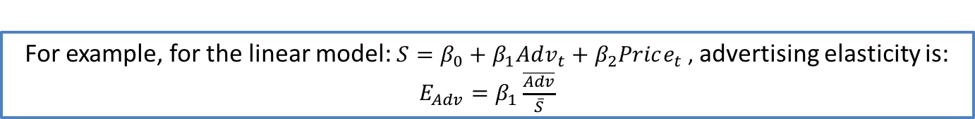
How to Calculate Elasticity of a Specific Marketing Action?
We know in real life it is almost impossible to guesstimate the sales lift attributed to a specific action.
We also know that a robust model enables correct attribution of effects across various independent variables.
Therefore, upon estimation and validation of a regression model, we can confidently calculate the elasticities of each focal decision variable, less the effects of control variables.
$$S=f\left(Advertising,Price, Promotions, Salesforce\right)$$
$$E_{Adv}=\frac{∂S}{∂Adv}\frac{\overline{Adv}}{\overline{S}}$$
Analytical average elasticity
For example, for the linear model: $S=β_{0}+β_{1}Adv_{t}+β_{2}Price_{t}$, advertising elasticity is: $E_{Adv}=β_{1}\frac{\overline{Adv}}{\overline{S}}$

Slide 40
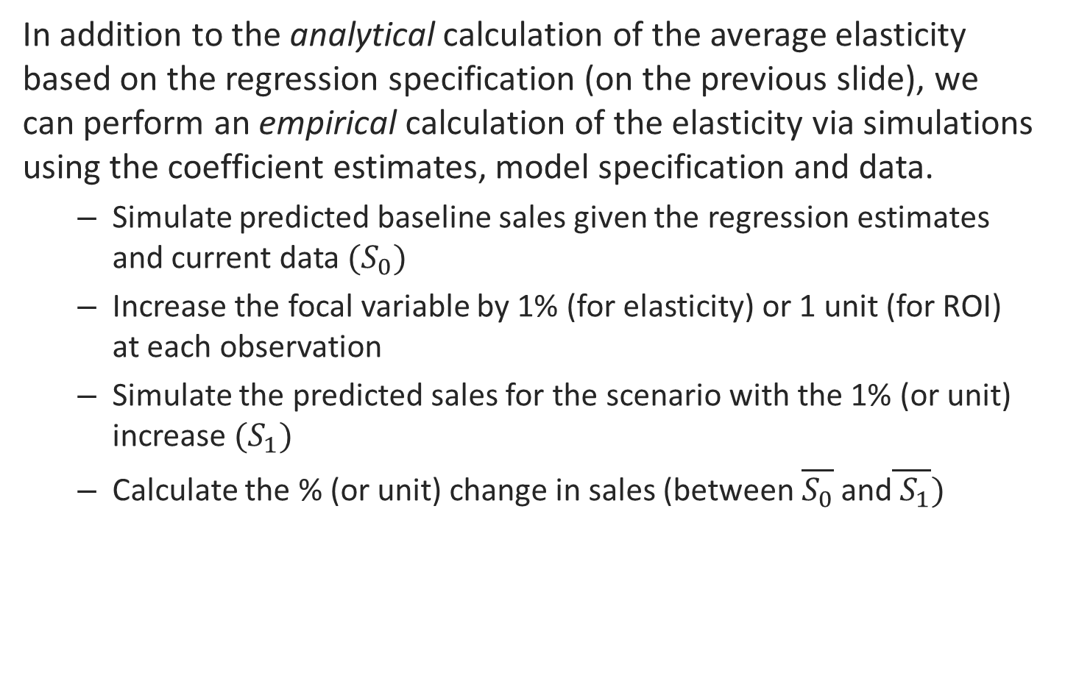
How to Calculate Elasticity of a Specific Marketing Action? (continued…)
In addition to the analytical calculation of the average elasticity based on the regression specification (on the previous slide), we can perform an empirical calculation of the elasticity via simulations using the coefficient estimates, model specification and data.
Simulate predicted baseline sales given the regression estimates and current data $(S_{0})$
Increase the focal variable by 1% (for elasticity) or 1 unit (for ROI) at each observation
Simulate the predicted sales for the scenario with the 1% (or unit) increase $(S_{1})$
Calculate the % (or unit) change in sales (between $\overline{S_{0}}$ and$\overline{ S_{1}})$
You can also calculate the elasticity at each time point with this method.

